Slide 1
TDOA Localization
Prepared by: Chan Jun Qiang
Updated on: 27 August 2025

Slide 2
Introduction to PD localization
The nature of PD happen at random, it is impossible to determine the PD time of arrival (TOA).
PD localization is different from GPS localization, because our phone and tower station have time synchronization where using TOA is possible. (because PD have no time synchronization)
Hence, to locate PD, we will be using 1 sensor as reference (usually sensor 1), to formulate the time difference of other sensors to the reference sensor, that is called time difference of arrival (TDOA).
To locate PD in 3 dimensions, at least 4 sensors are required (if 2 dimensions, need at least 3 sensors).

Slide 3

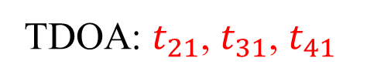




TDOA fundamental
1
When sensors located at different locations and the PD signal’s TOA to each sensor will be different.
Eg: the sensor that is nearest to PD will have earlier TOA compared to other sensor.
$$PD$$
Voltage
2
First peak detection to extract TOA as well as TDOA.
The time of PD measured by antenna is in nano seconds.
$$D m$$
TDOA: $t_{21}$, $t_{31}$, $t_{41}$
time
sensor 1
time
sensor 2
$$t_{21}$$
time
3
Conventionally, to find PD (x, y, z) coordinate, usually solving nonlinear equations using iterative methods (see next page).
sensor 3
$$t_{31}$$
sensor 4
time
$$t_{41}$$

Slide 4
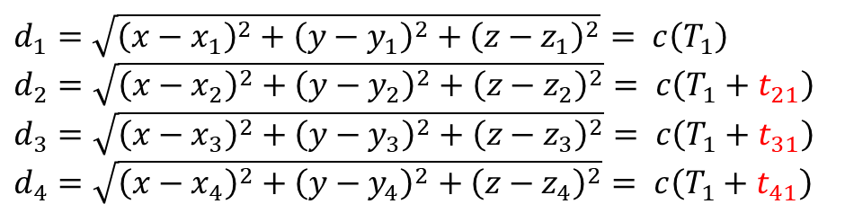

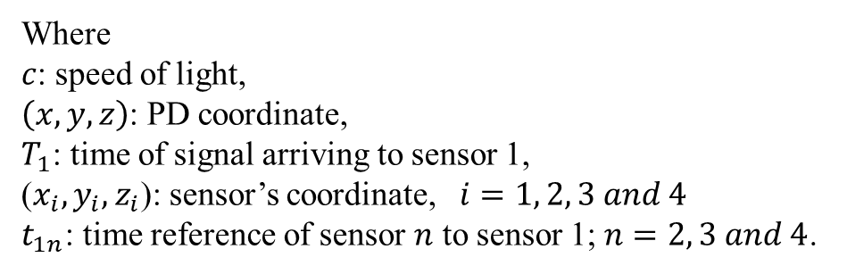
#1 Conventional method: optimization algorithm or iterative algorithms
1
Non-linear Equations (derived from $c=d/t$):
2
Algorithms such as newton iterative, particle swarm optimization, ant colony optimization, whale optimization algorithms, grey wolf optimization and etc.
$d_{1}=\sqrt{{\left(x−x_{1}\right)}^{2}+{\left(y−y_{1}\right)}^{2}+{\left(z−z_{1}\right)}^{2}}= c\left(T_{1}\right)$
$d_{2}=\sqrt{{\left(x−x_{2}\right)}^{2}+{\left(y−y_{2}\right)}^{2}+{\left(z−z_{2}\right)}^{2}}= c\left(T_{1}+t_{21}\right)$
$d_{3}=\sqrt{{\left(x−x_{3}\right)}^{2}+{\left(y−y_{3}\right)}^{2}+{\left(z−z_{3}\right)}^{2}}= c\left(T_{1}+t_{31}\right)$
$d_{4}=\sqrt{{\left(x−x_{4}\right)}^{2}+{\left(y−y_{4}\right)}^{2}+{\left(z−z_{4}\right)}^{2}}= c\left(T_{1}+t_{41}\right)$
Where
$c$: speed of light,
$\left(x, y, z\right)$: PD coordinate,
$T_{1}$: time of signal arriving to sensor 1,
($x_{i}, y_{i},z_{i}$): sensor’s coordinate, $i=1, 2, 3 and 4$
$t_{1n}$: time reference of sensor $n$ to sensor 1; $n=2, 3 and 4$.
3
Limitations of iterative algorithms:
Slow computation.
Prone to stuck at local minima, lead to poor accuracy.

Slide 5
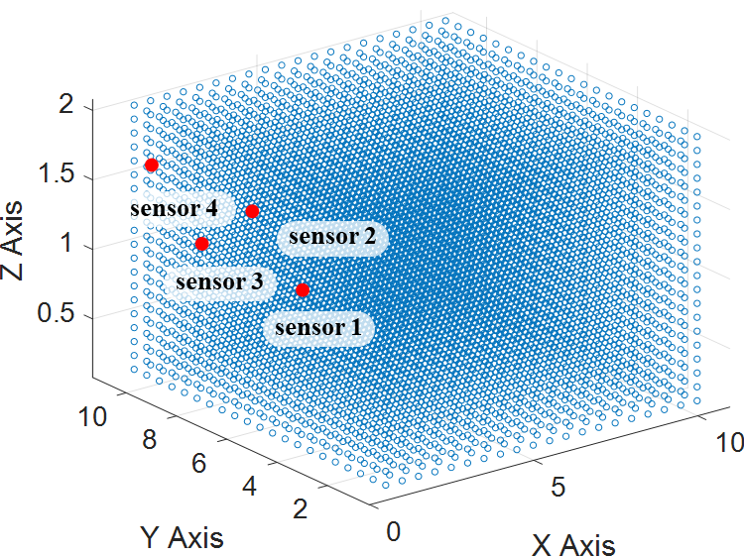
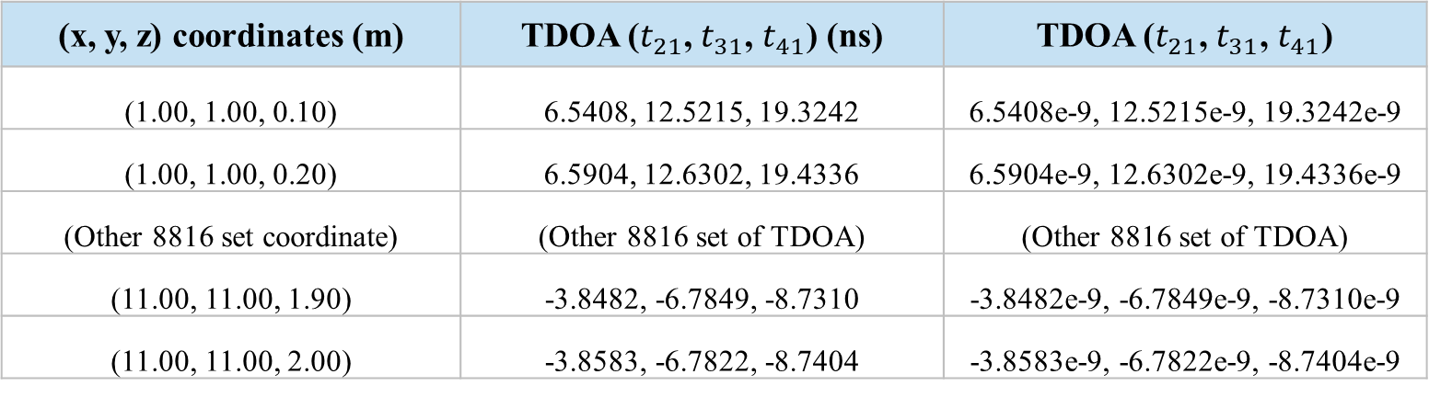
#2 Machine learning:
2
Grid sizes refer to the distance between each point, that forming the whole 3D volume (whole dataset), as illustrated below.
1
Forming dataset with following data preprocessing:
Training and Validation split: randomly into 70:30 ratio.
Data Precision Value: The grid sizes adjusted to achieve centimetre-level precision.
Normalization: converting TDOA values to nano second suffix.
Feature Engineering: Additional features to enhance the learning capability of the model.
3
Example of dataset: 8820 dataset size
(x, y, z) coordinates (m) | TDOA ($t_{21}$, $t_{31}$, $t_{41}$) (ns) | TDOA ($t_{21}$, $t_{31}$, $t_{41}$)
(1.00, 1.00, 0.10) | 6.5408, 12.5215, 19.3242 | 6.5408e-9, 12.5215e-9, 19.3242e-9
(1.00, 1.00, 0.20) | 6.5904, 12.6302, 19.4336 | 6.5904e-9, 12.6302e-9, 19.4336e-9
(Other 8816 set coordinate) | (Other 8816 set of TDOA) | (Other 8816 set of TDOA)
(11.00, 11.00, 1.90) | -3.8482, -6.7849, -8.7310 | -3.8482e-9, -6.7849e-9, -8.7310e-9
(11.00, 11.00, 2.00) | -3.8583, -6.7822, -8.7404 | -3.8583e-9, -6.7822e-9, -8.7404e-9
✅
❌

Slide 6
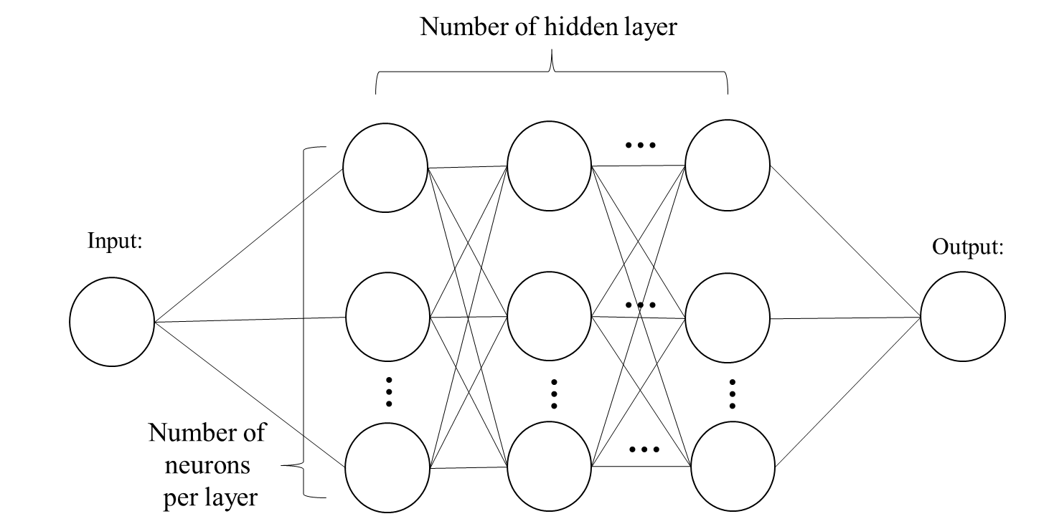
#2 Machine learning (Cont.)
1
Model such as feedforward neural network, 1-dimensional Convolutional Neural Network, Random Forest Regression, Gaussian Process Regression, Fully Connected Neural Network (FCNN) – Deep Neural Network.
2
The best model was DNN (below) with 5 hidden layers, 4096 neurons per layer, 0.0001 learning rate.
TDOA Features
PD coordinate
(x, y, z)
3
Strength of ML:
Instant prediction.
Well-trained model able to redeploy to new 3D environment without retraining.

Slide 7
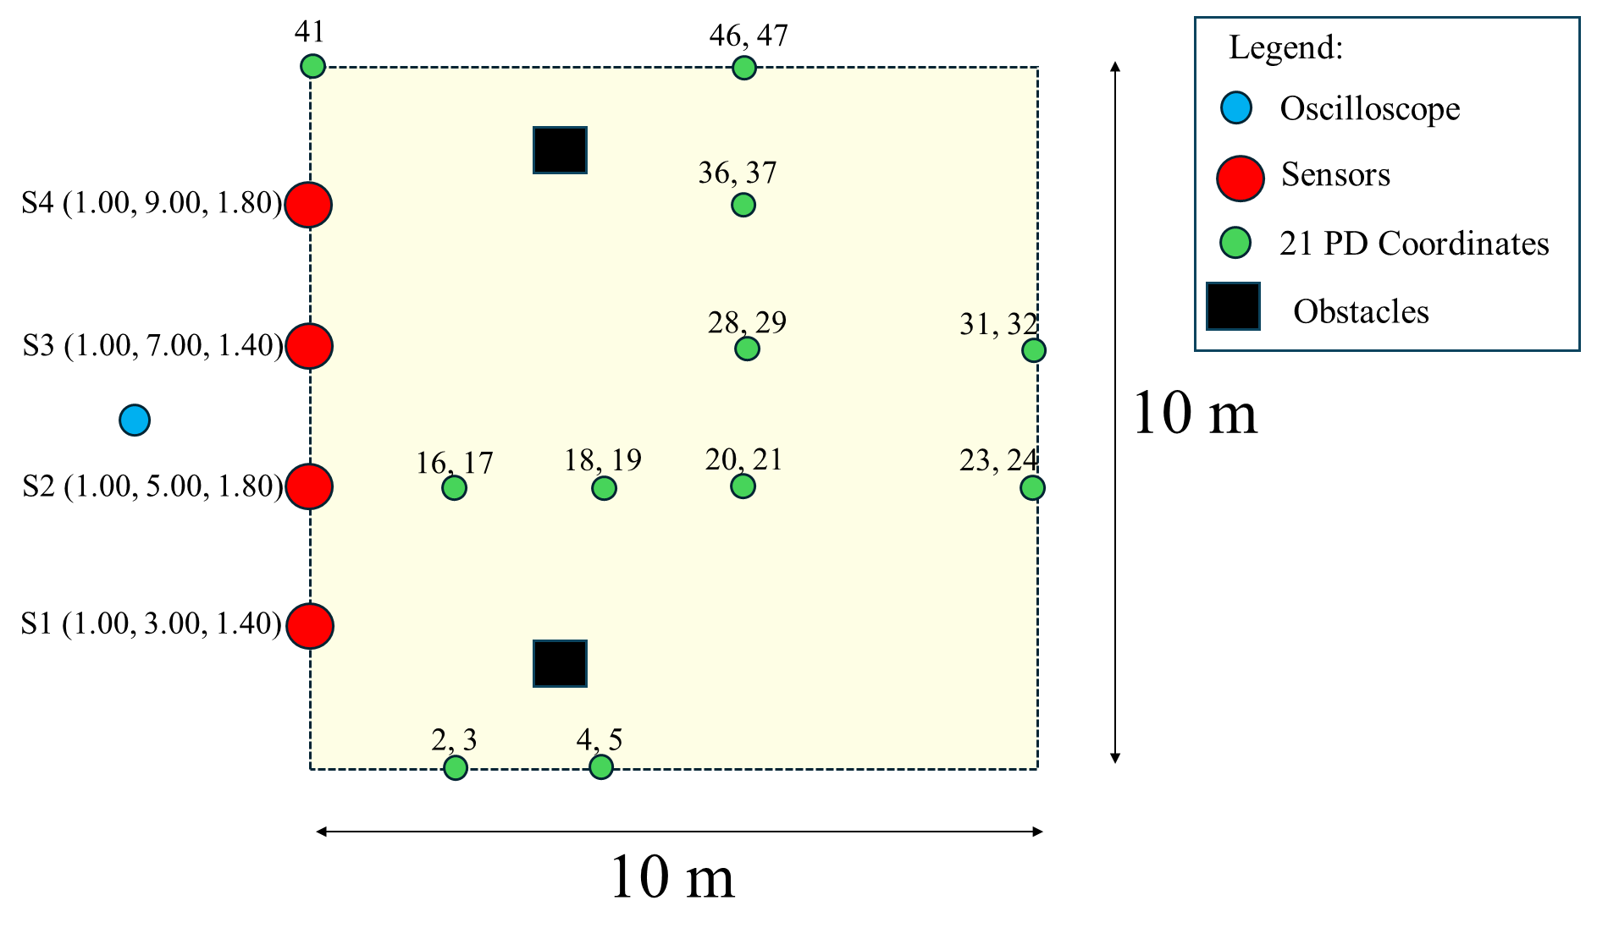
Measured locations
1
This is an optimal sensor placement (after comparing and analyzed with others placement).
2
2 values at one location indicated 2 different heights.
3
For each location, 10 set of signals were collected.
However, after postprocessing of each signal, only those well presented signals were selected and shown in ‘func_Sensors_Data.m’ (see next page).

Slide 8
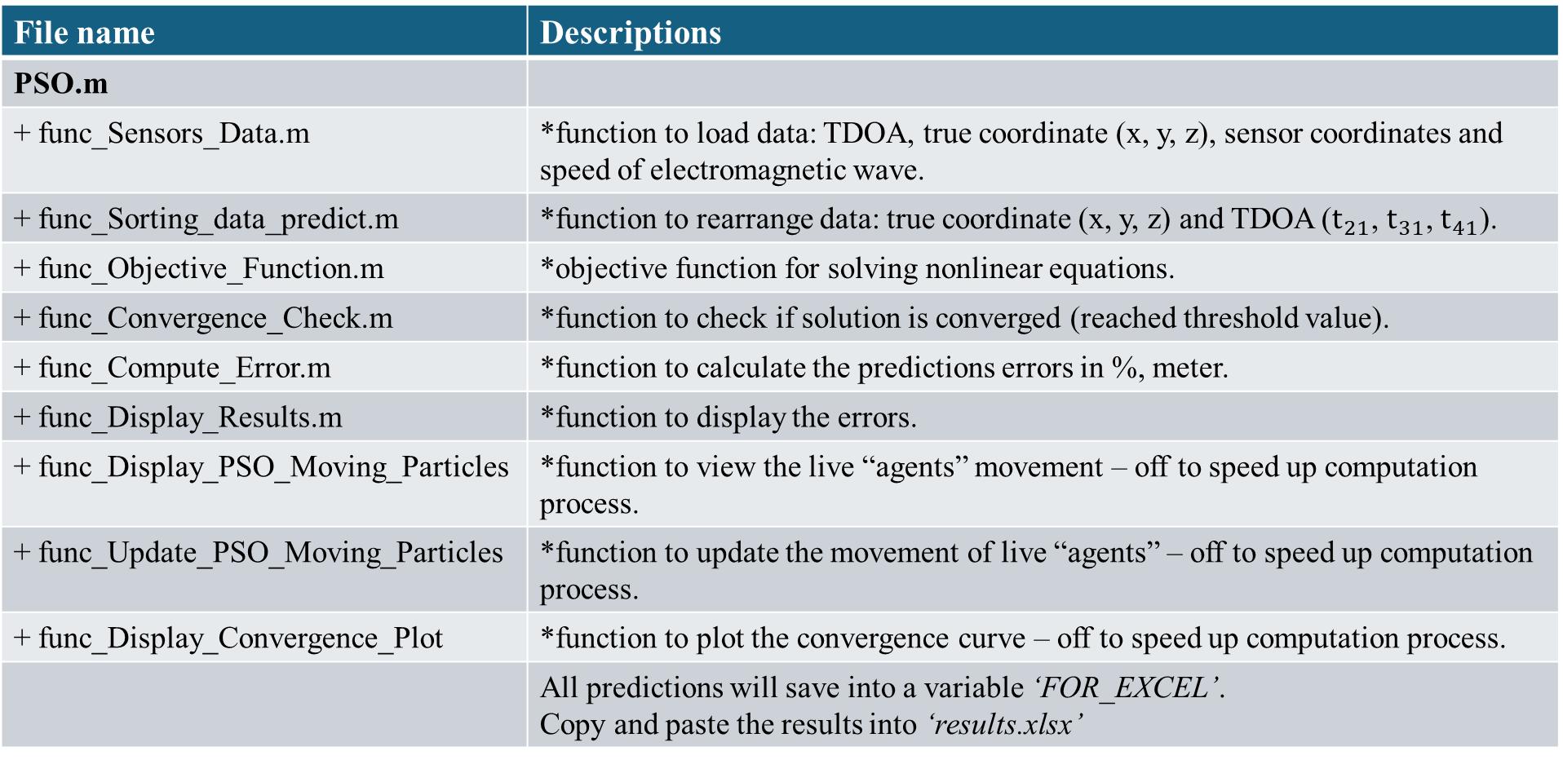
Performing localization (iterative algorithm)
File name | Descriptions
PSO.m
+ func_Sensors_Data.m | *function to load data: TDOA, true coordinate (x, y, z), sensor coordinates and speed of electromagnetic wave.
+ func_Sorting_data_predict.m | *function to rearrange data: true coordinate (x, y, z) and TDOA ($t_{21}$, $t_{31}$, $t_{41}$).
+ func_Objective_Function.m | *objective function for solving nonlinear equations.
+ func_Convergence_Check.m | *function to check if solution is converged (reached threshold value).
+ func_Compute_Error.m | *function to calculate the predictions errors in %, meter.
+ func_Display_Results.m | *function to display the errors.
+ func_Display_PSO_Moving_Particles | *function to view the live “agents” movement – off to speed up computation process.
+ func_Update_PSO_Moving_Particles | *function to update the movement of live “agents” – off to speed up computation process.
+ func_Display_Convergence_Plot | *function to plot the convergence curve – off to speed up computation process.
 | All predictions will save into a variable ‘FOR_EXCEL’. Copy and paste the results into ‘results.xlsx’
1

Slide 9
Performing localization (DNN)
File name | Descriptions
Digital_Twin_Data_Generation.m | Digital Twin (simulated) data generation.
1. 33_Train_Coordinates.mat 2. 33_Train_TDOA.mat | 1,102,947 training dataset (70%).
3. 33_Val_Coordinates.mat 4. 33_Val_TDOA.mat | 472,692 validation dataset (30%).
GridSearch3D.m | Training and validation of DNN model.
+ func_load_data.m | *function to load dataset.
best_model_33.mat | Trained DNN model.
best_model_36_0.1gz_0.2r.mat | Trained DNN with augmented data.
Prediction3D.m | Using the trained DNN to perform predictions.
+ func_Sensors_Data.m | *function to load TDOA data, actual x, y, z coordinates and sensor coordinates.
+ func_Compute_Error.m | *function to calculate the predictions errors in %, meter.
+ func_Display_Results.m | *function to display the errors.
 | All predictions will save into a variable ‘FOR_EXCEL’. Copy and paste the results into ‘results.xlsx’
2
3
4

